Slide 1
Efficient User Clustering Using a Low-Complexity Artificial Neural Network (ANN) for 5G NOMA Systems
Presented by,
Name: Nausheen Samiha
ID:18101108

Slide 2
Introduction
Non-orthogonal multiple access (NOMA) has gained considerable interest from the 3GPPcommunity as a potential radio access strategy for the future fifth-generation (5G) wireless networks.
Artificial neural network (ANN) approach is proposed for user clustering in the downlink of the 5GNOMAsystem in order to maximize throughput performance at an acceptable complexity. In

Slide 3
PRIOR WORKS
The NOMA techniques can generally, be categorized into two variants
1) power-domain and
2) code-domain
Most of the proposed are complex to implement.

Slide 4
MOTIVATIONS AND CONTRIBUTIONS
obtaining a globally optimal solution is nontrivial especially in grouping a large number of NOMA users which motivates the application of machine learning (ML) model.
Among the different types of ML algorithms, articial neural network (ANN) is one of the most powerful ML algorithms that has been used in recent decades in a variety of tasks to model regression analysis and prediction problems due to its imitative nature.
proposed an ANN-based user clustering frame-work to implement the NOMA scheme which exploits the transmitting power, channel gain features and user cluster information of the NOMA users.

Slide 5


SYSTEM MODEL (NOMA SYSTEM)
The
received signal of user m on subcarrier n can be expressed as,

Slide 6
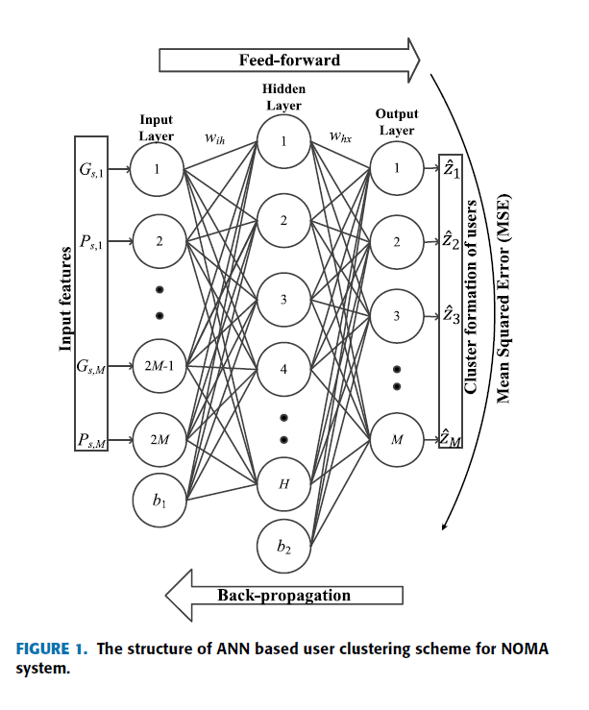
PROPOSED ARTIFICIAL NEURAL NETWORK (ANN) BASED USER CLUSTERING
the dataset comprises the transmit powers, channel gains, and cluster formation for various deployment scenarios (e.g., different number of users and different user positions), is utilized to train the ANN.

Slide 7
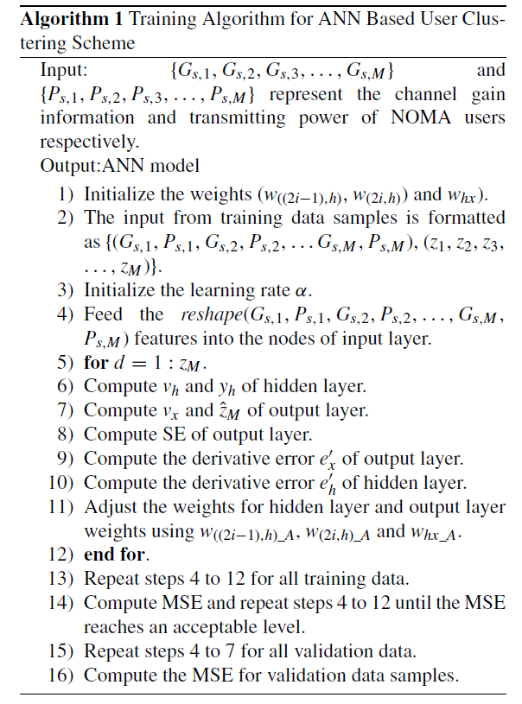
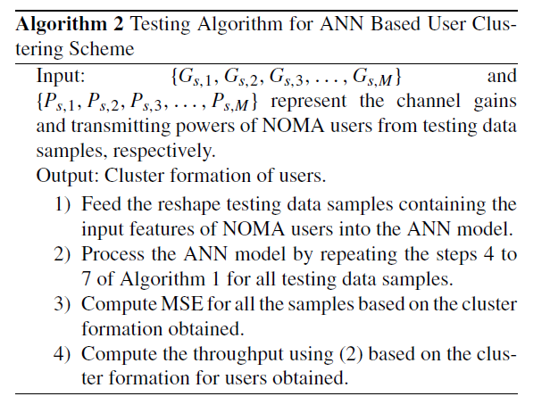
STRUCTURE OF THE ANN BASED USER CLUSTERING

Slide 8
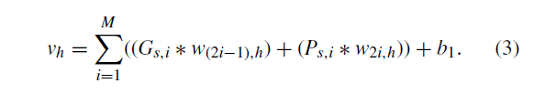


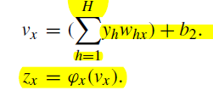

FEED FORWARD COMPUTATION

Slide 9


BACK-PROPAGATION AND WEIGHT ADJUSTMENT

Slide 10
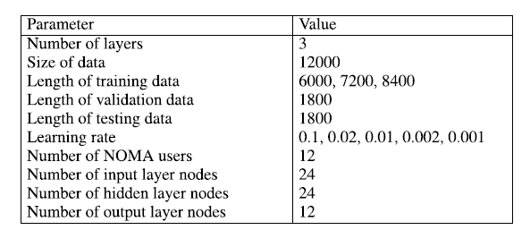
NUMERICAL RESULTS AND DISCUSSIONS
specially, the throughput and the MSE performance of the proposed scheme for different settings of learning rate, lengths of the training samples, and number of epochs are investigated

Slide 11
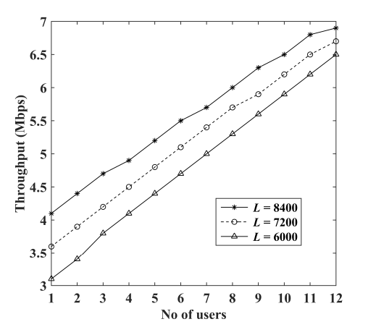
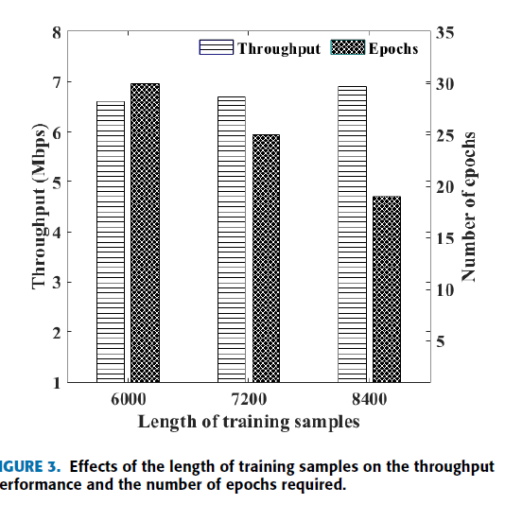
NUMERICAL RESULTS AND DISCUSSIONS

Slide 12
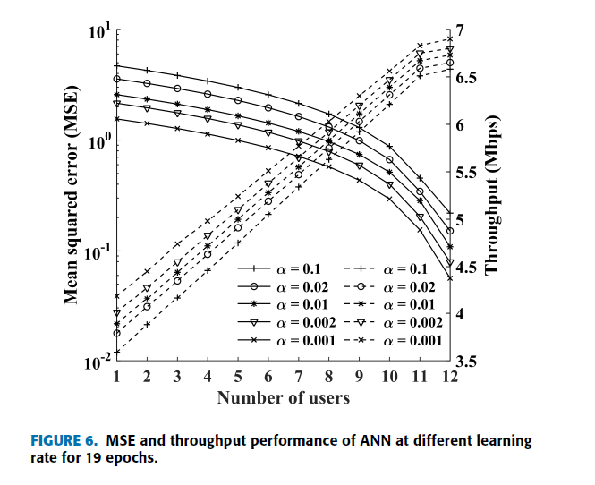
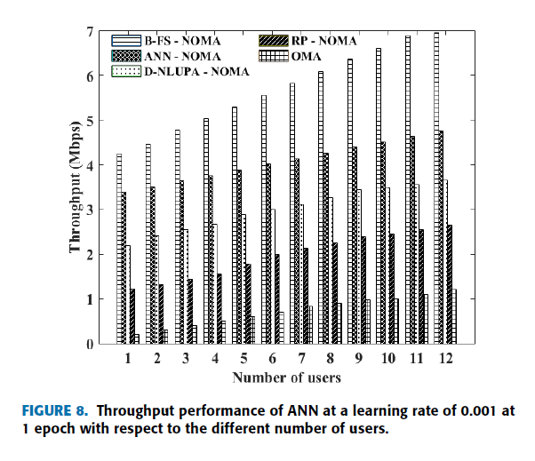
NUMERICAL RESULTS AND DISCUSSIONS

Slide 13
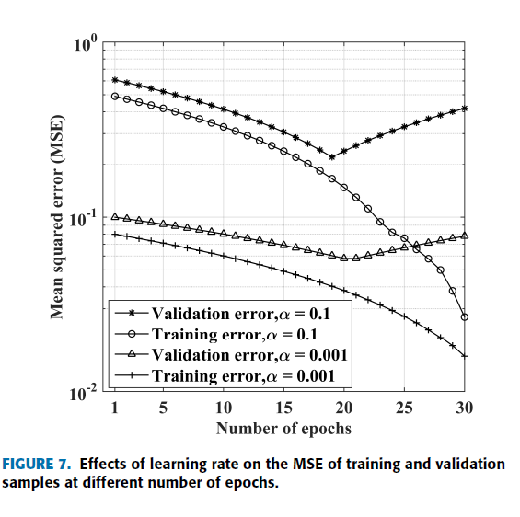
NUMERICAL RESULTS AND DISCUSSIONS

Slide 14
CONCLUSION
approaches, the proposed scheme automatically groups the users into clusters based on the decision obtained during the training process which results in near-optimal throughput performance.

